Slide 1
CYB 110 CYBERSECURITY AND PRIVACY MODULE 2 – IDENT. & AUTHENTICATION JIM ALVES-FOSS AND JIA SONG

Slide 2
IDENTIFICATION +
One way to ensure C.I.A. is to make sure that only authorized individuals/entities are allowed access.
Read, write, modify, create, destroy, execute, install …
First, we need to know WHO requesting access.
This involves: Identification, Verification, Authentication

Slide 3
IDENTIFICATION
There are two aspects of identification.
Claimed identity.
Enter a username, email, real name into a computer system
Compare to telling a name, showing an id?
Detected identity
Facial scanning, other biometric (discussed later)

Slide 4
WHY IDENTIFICATION NOT ENOUGH
We have a claimed identity.
Why is that not enough?
Bad guys lie, cheat and steal.

Slide 5
VERIFICATION
Can we verify identity?
Real world:
Show an identity card (drivers license).
Look up in a database to compare photograph
Computer systems:
Do we verify or just assume the stated identity is true?
Do we “trust” that some other entity did verification?
Identities can be falsified:
Fake IDs (to show wrong age)
Online identity theft to get credit cards, …
$16.8Billion in US in 2017

Slide 6
AUTHENTICATION
Improves on Verification. We use what are called “Factors”.
What you know: password, PIN, answer to secret question
What you have: ATM card, cell phone, smart token
What you are: biometrics (more on this later)
What you do: keystroke patterns, voice patterns, signature recognition
Where you are: at a specific location, using a specific device (trusted path)

Slide 7
MULTIFACTOR AUTHENTICATION
Passwords, ATM cards, credit cards, etc can be stolen.
Multifactor authentication requires more than one of these:
Two factor authentication is common:
You claim an identity, share what you know (password) and then what you have (smart tokent, cell phone)
Dual-factor (duo) …
This is a huge improvement on single factor. Many security breaches involve theft of credentials so someone can fake an identity. Much harder to do if requires two factors.

Slide 8
MUTUAL AUTHENTICATION
How do both parties in a communication verify each other?
I go to my bank’s web site.
The ask my identity, password and then send a code to my phone.
How do I know they are who they say they are? In this case often just strong single-factor.
There is a well-know class of attacks called “man-in-the-middle” where an attacker intercepts and relays messages between a real client and real server.

Slide 9
COMMON IDENTIFICATION & AUTHENTICATION
Passwords and PINs
A secret value known by the user, and registered/stored with the server.
PINs are simpler because they assume you also have physical possession of an identity card (ATM, Credit,…)
Passwords must be
Hard to guess
Stored in a secure manner on server
Transmitted in a secure manner between client and server
Timely

Slide 10
PASSWORDS
Storage
Standard practice is to store encrypted password on the server, usually using a 1-way function.
1-way function
Encrypted password + ID
Original Password
Password Database
1-way function
Encrypted password
Password for Claimed ID
Entered Password
Compare

Slide 11
1- WAY FUNCTION?
Normal Encryption:
Encrypt(Key, Plaintext) = Cryptotext
Decrypt(Key, CryptoText) = Plaintext
To break, need to find key to recover message
1-way function:
Encrypt(Plaintext as key, 0) = Cryptotext
Decrypt == does not exist
Seed
random value that modifies cryptofunction to make attacks harder.

Slide 12
PASSWORDS (2)
Try 100 million passwords per second:
Find 2 x 10¹¹ in 30 minutes
Find 5 x 10¹³ in 6 days
Find 2 x 10¹⁴ in 25 days
Find 7 x 10¹⁴ in 83 days
Find 3.7 x 10¹⁸ in 1,187 years
What makes a good password?
Broader alphabet
All lower case 8 characters = 26⁸ possible (2 x 10¹¹)
Upper and lower case = 52⁸ possible (5 x 10¹³)
Add numbers = 62⁸ possible (2 x 10¹⁴)
Add one of 10 special characters = 72⁸ possible (7 x 10¹⁴)
Make 10 characters long = 72¹⁰ possible (3.7 x 10¹⁸)
AND
Not from a standard dictionary, or list of known passwords.
Best – take a phrase that is known to you and modify it:
I got into Hogwarts -> iGotIn2:PigWarts

Slide 13
PASSWORDS (3)
What about access to multiple systems
Best to use a unique password
How?
For a website: Pick something about that site that you remember and use that to modify a standard password:
SteamOnline :
iGotIn2:Pigwarts -> iGotIn2:PigWarts@H2OWeb
WellsFargo Bank:
iGotIn2:Pigwarts -> iGotIn2:PigWarts4Stage$

Slide 14
BIOMETRICS
Fingerprint, Iris scanner, Facial Recognition, ..
Universality – does everyone have this?
Uniqueness – how unique per person?
Permanence – can it change?
Collectability – how to we store data on server?
Performance – how reliable/fast?
Acceptability – do people mind?
Circumvention – can we get around it?

Slide 15
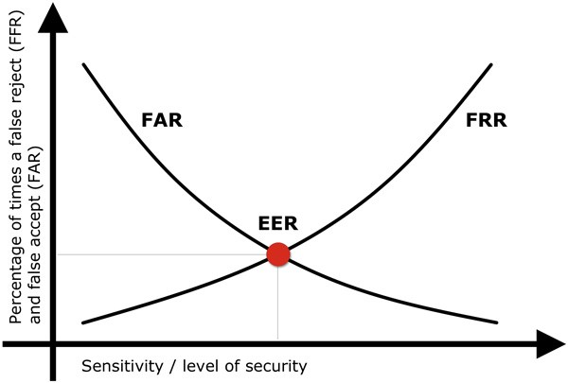
BIOMETRICS (2)
Measuring Performance:
False acceptance (false positive)
False rejection (False negative)
Need to optimize these

Slide 16
BIOMETRICS (3)
Flaws in the systems
What if compromised (how many fingers can I use?)
Are their privacy concerns?
Can they be easily spoofed?
Are they really unique/or unique enough?
How is the original data stored? (Can we use one-way functions?)

Slide 17
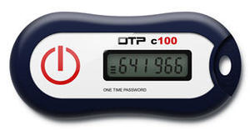
HARDWARE TOKENS
Dongles/USB devices/One time passcodes
Server has algorithms synced with device.
Each unique device registered to a user.
New number generated either with push of button (event based)
Based on counter, and server has “Window” of valid codes
Or time based
Updated every 30-60 seconds

Slide 18
PLEASE ATTRIBUTE DR. JIM ALVES-FOSS AND DR. JIA SONG, UNIVERSITY OF IDAHO EXCEPT WHERE OTHERWISE NOTED, THIS WORK IS LICENSED UNDER HTTPS://CREATIVECOMMONS.ORG/LICENSES/BY-NC-SA/4.0/ NOT WITHSTANDING THE NON-COMMERCIAL LICENSE TERMS, NON-PROFIT EDUCATIONAL INSTITUTIONS ARE GRANTED A NON-EXCLUSIVE LICENSE TO ADAPT AND USE THIS MATERIAL, WITH ATTRIBUTION. CREATIVE COMMONS AND THE DOUBLE C IN A CIRCLE ARE REGISTERED TRADEMARKS OF CREATIVE COMMONS IN THE UNITED STATES AND OTHER COUNTRIES. THIRD PARTY MARKS AND BRANDS ARE THE PROPERTY OF THEIR RESPECTIVE HOLDERS.

